Slide 1
Heart Disease Predictor
A new hybrid knowledge-based system using PRISM classifier and parallel genetic algorithm for diagnosis of heart disease
Vibhor Chaturvedi (BE/10223/2014)
Rajat Jain (BE/10235/2014)
S.Shree Vignesh (BE/10242/2014)
Mentor : Dr. B.K. Sarkar Sir

Slide 2

Why of the project
Heart diseases are and have been very common in elderly people, complicating lives and posing danger. According to 2009 WHO survey, 1 out of every 4 deaths in the world on an average is caused from a heart disease. To get a premature knowledge and understanding of the ailment before it has taken a big form, is an important aspect in its diagnosis. This is why we chose this project so as to help make this world a better place to live in.

Slide 3
Abstract
In the present research, a new hybrid model (integrating PRISM learner and GA) is to be introduced for effective diagnosis of heart disease, addressing the limitations of the existing systems. In particular, the model suggests here a two-level optimization strategy, where level-1 first attempts to identify parallelly an optimal proportion (P_{opt}) for training and test sets for each Heart dataset using PRISM learner on Cluster-based HPC machine. Next, the best training set (T_{best}) for P_{opt} is to be searched again parallelly by the same learner. On the other hand, level-2 optimization aims to refine the rule-set(R) generated by the PRISM learner on T_{best} by employing parallel genetic algorithm(PGA).

Slide 4
Introduction

Slide 5
What are genetic algorithms?
Genetic algorithms are inspired by Darwin's theory about evolution. Solution to a problem solved by genetic algorithms is evolved.
Algorithm is started with a set of solutions (represented by chromosomes) called population. Solutions from one population are taken and used to form a new population. This is motivated by a hope, that the new population will be better than the old one. Solutions which are selected to form new solutions (offspring) are selected according to their fitness - the more suitable they are the more chances they have to reproduce.
This is repeated until some condition (for example number of populations or improvement of the best solution) is satisfied.

Slide 6
Outline of basic genetic algorithm
[Start] Generate random population of n chromosomes (suitable solutions for the problem)
[Fitness] Evaluate the fitness f(x) of each chromosome x in the population
[New population] Create a new population by repeating following steps until the new population is complete
[Selection] Select two parent chromosomes from a population according to their fitness (the better fitness, the bigger chance to be selected)
[Crossover] With a crossover probability cross over the parents to form a new offspring (children). If no crossover was performed, offspring is an exact copy of parents.
[Mutation] With a mutation probability mutate new offspring at each locus (position in chromosome).
[Accepting] Place new offspring in a new population
[Replace] Use new generated population for a further run of algorithm
[Test] If the end condition is satisfied, stop, and return the best solution in current population
[Loop] Go to step 2

Slide 7
About the project
This project consists of two parts, i.e, two levels of optimization. Our part was to carry the project forward with the second level of optimization.
Data level (level-1) optimization
· Deciding an optimal proportion for training and test sets in parallel manner using PRISM learner
· Finding parallelly the best training set for the identified proportion using PRISM learner
Rule-level (level-2) optimization
Hybrid model: (PRISM+PGA)

Slide 8
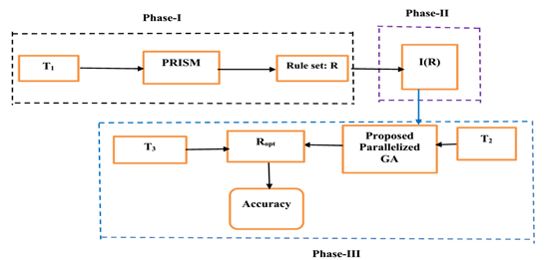
The hybrid model

Slide 9
The exact hybrid model and level -2 optimisation
To build the exact model, each heart dataset (D) is first split into three sub-sets, namely T₁, T₂ and T₃ as follows.
· T₁ : This set is, indeed, the best training set (containing m% examples of each class) and it is found by adopting the strategy (under level-1 optimization). This is used by the PRISM learner to generate a rule set (R).
· T₂ : 20% examples of each class are selected at random from (D-T₁) and included into T₂. Simultaneously, these examples are removed from (D-T₁). This set is basically used by the suggested PGA to refine the rule set R.
· T₃ : It is now D –(T₁+T₂). The optimized rules set finally finds accuracy over this sub-set.

Slide 10
Literature Review

Slide 11
Literature reviewed
Sr. No. | Analysis | Date
1. | JADZIA CENDROWSKA C/O The Faculty of Mathematics, The Open University, Walton Hall, Milton Keynes, MK7 6AA, U.K. | (29/05/1987)
2. | A Classification Rules Mining Method based on Dynamic Rules' Frequency | (2015)
3. | Article on Malnutrition Detection and Management System | (Jan-March 2015)

Slide 12
Genetic Operators
Selection, crossover and mutation
As you can see from the genetic algorithm outline, the crossover and mutation are the most important part of the genetic algorithm. The performance is influenced mainly by these two operators.

Slide 13
Selection of rules :
As we already know from the GA outline, chromosomes are selected from the population to be parents to crossover. The problem is how to select these chromosomes. According to Darwin's evolution theory the best ones should survive and create new offspring. There are many methods how to select the best chromosomes, for example roulette wheel selection, Boltzman selection, tournament selection, rank selection, steady state selection and some others.

Slide 14


Crossover (reproduction operator):
Single point crossover - one crossover point is selected, binary string from beginning of chromosome to the crossover point is copied from one parent, the rest is copied from the second parent
11001011+11011111 = 11001111
Two point crossover - two crossover point are selected, binary string from beginning of chromosome to the first crossover point is copied from one parent, the part from the first to the second crossover point is copied from the second parent and the rest is copied from the first parent
11001011 + 11011111 = 11011111

Slide 15

Bit inversion - selected bits are inverted
11001001 => 10001001
Mutation :

Slide 16
Fitness Function
A fitness function is essentially an objective function for any problem, and it depends upon the nature of the problem. The function gives a means of evaluating a solution for its inclusion in the resulting set. From the perspective of decision making, factors such as prediction-accuracy, error (i.e., misclassification) rate, true positive rate, etc. are essentially considered for constructing fitness function.

Slide 17
Proposed Methodology

Slide 18
Sort all species according to their fitness values and pick the topmost n species.
Calculation of fitness values of species new offsprings
Best dataset classified using rule based induction (PRISM Algorithm
Repeat for 1000 times
After m iterations
Adding the offsprings back to population
Decoding
Encoding and creation of population
Repeat for m times
Mutation
Two point crossover
Selection of two random species

Slide 19
Suggested Encoding scheme
From the chosen discretized heart datasets, it has been observed that the largest value of any attributes among all the datasets does not exceed 7. Hence, 3 bits are sufficient to encode each attribute. Accordingly, 3x13=39 bits in total are necessary to represent every rule of the datasets, viz., Heart(Cleveland), Heart(Hungarian) and Heart(Swiss), since each of these databases has total 13 attributes (including) the class attribute. However, this size becomes 3x14=42 bits for Heart(Statlog) because this set contains total 14 attributes (including the class attribute).
As per this representation, if ‘*’ appears in a rule for an attribute, then this symbol is simply encoded as: 000. On the other hand, an equivalent binary coding is adopted for values other than ‘*’. This technique is undoubtedly one of the easiest implementation techniques for encoding the rules.

Slide 20
Suggested Decoding scheme
We know that decoding is the reverse process of encoding. The decoding strategy adopted in the present study is briefly stated below. In particular, the following steps are applied during decoding.
Step-1: Access the binary stream block by block, each of size 3 bits.
Step-2: For each block, the value v is computed as the decimal equivalent of that stream.
Step-3: If v=0, then place ‘*’ at the position of the attribute corresponding to its block,
(except for the target attribute)
else if (v > a_{max}), then place the scaled value v_{s} = ceil( v_{s}/a_{max}) at that position,
where a_{max} denotes the maximum value yield by that attribute,
else place simply the computed value at that position.

Slide 21
Selection of rules:
In this research, the selection of parents for performing crossover is made at random. Here, the rules in the rule set (i.e., population) are numbered as: 1, 2, . . ., n. Now, two parents say: p₁and p₂ are picked randomly from the current rule set with n rules, and placed them into a mating pool (say M). Thus, the probability of a selecting rule in a rule set (with n rules) is: 1/n.

Slide 22
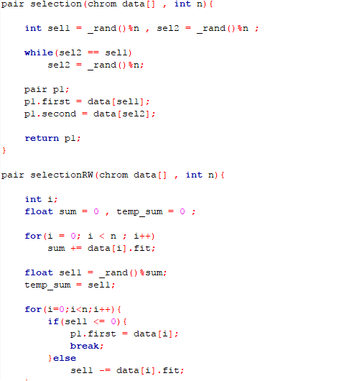
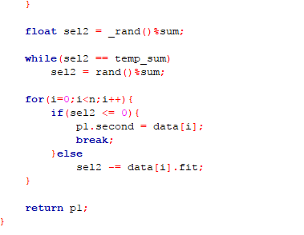

Slide 23
Crossover of selected rules :
The present study performs two-point cross-over technique, where two distinct points: x_{i} (i = 1, 2) are again chosen randomly within 1 < x_{i} < L. Finally, the heads and tails (the parts respectively before and after the cutting points) of the parents are swapped. Obviously, probability (p_{c}) of selecting any crossover point is : 1/L.

Slide 24
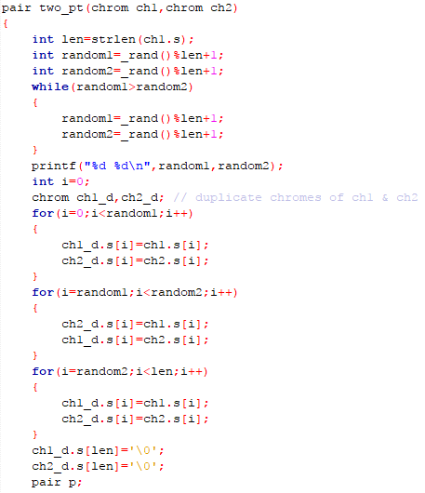


Slide 25
Mutation :
As per the basic concept of mutation operation in GA, a zero (‘0’) is changed to one (‘1’) and vice versa for a binary coded solution. Here, single point mutation (selected at random within the length L) is performed after crossover. Thus, p_{m}(probability of selecting any mutation point) is 1/L . Now, the above mentioned three steps combinedly result two new individuals: say O₁ and O_{2.}

Slide 26
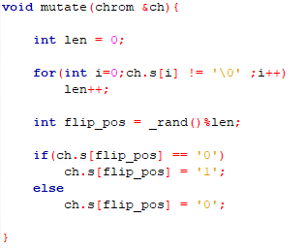

Slide 27
Fitness Function
Keeping the point in mind that the heart databases are imbalanced in nature, fitness function for measuring fitness value of each rule (r ) in rule set (I(R)) is
f(r) =( ( m - n ) / n_{ci} ) + ( 1/k )
where m and n represent respectively the numbers of training examples correctly and incorrectly classified by r over T₂. Further, k represents the number of pre-conditions present in the rule r and n_{ci} is the number of examples of class c_{i} present in T₂ such that the class-label of rule r is also c_{i}.

Slide 28
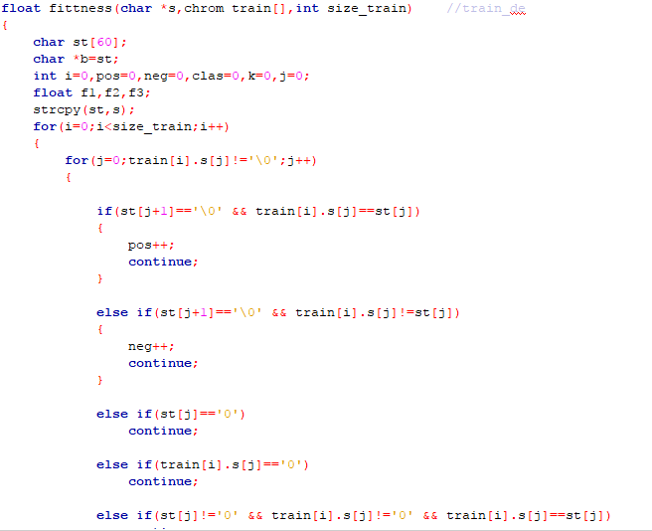
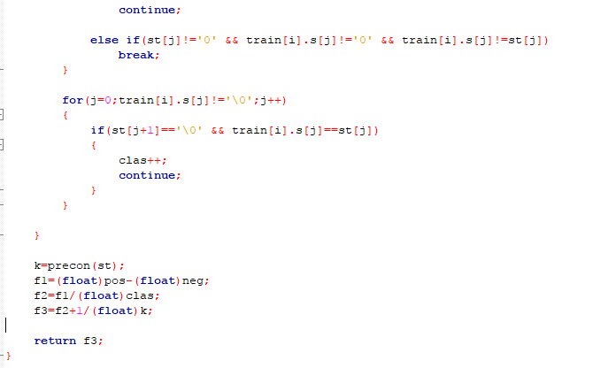

Slide 29
Algorithmic version of the proposed SGA model
Variable: R: rule set where each rules in ‘IF- THEN’ format
I(R) : Rule set (R) in tabular form
O₁, O₂, r₁, r₂ : rule of I(R) format
ctr = 0, Max_itr // Max_itr says the maximum number of iterations
Step-1 Randomly selects two rules (solutions), say r₁ and r₂ from I(R)
Step-2: Apply the suggested two-point crossover and then mutation points on r₁
and r₂ to result two new distinct offspring: O₁ and O₂ (in decoded form).
Step-3: Check the rule-redundancy and rule-conflict cases for each of O_{i} (i =1, 2) with the rules
present in R following the strategy presented in the next section, and take action(s) appropriately.
Step-4: If O_{i} (i=1, 2) is correct (i.e., neither redundant nor conflict), then evaluate fitness score of
each O_{i} (i=1, 2).
Step-5: Choose the best rule (r_{best}) based on fitness score over T₂.
Step-6: Replace the worst rule: r_{worst} with the r_{best} if possible.
Step-7: ctr =ctr +1. If (ctr < Max_itr), then goto Step-1.

Slide 30
Managing redundant and conflict rules
To understand the idea on distinct rule, identical rule and conflict rule, let us take a discretized dataset of a classification problem (P) with 4 non-target attributes, say A₁, A₂, A₃ and A₄ and class (i.e., target) attribute, say C.

Slide 31
Managing redundant rules
Two rules: r₁ and r₂ are identical if min (|pre(r₁)|, |pre(r₂)|) = match(pre(r₁), pre(r₂)), where |pre(r_{i})| results the number of pre-conditions (each with a numerical value) present in rule: r_{i} and the function: min(m₁, m₂) returns the minimum between two numbers: m₁, m₂.
Let r₁ and r₂ be two decision rules for P as follows:
· r₁: If (A₁=4) and (A₂= 2) and (A₄=1), then C=1
· r₂: If (A₁=4) and (A₄=1), then C =1
The number of pre-conditions present in r₁ is 3, whereas it is 2 in r₂. In fact, the rules match at two places except for (A₂=2) in r₁. Clearly, the number of matched pre-conditions (m) is here 2 (i.e.,m =2). Again, min (|pre(r₁)|, |pre(r₂)|)= min(3,2) returns 2, and it equals to m.
Hence, both the rules are identical but one supersedes the other. In other words, out of these two rules, one is the super rule of the other. It is observed that |pre(r₂)| =2 , and it is less than |pre(r₁)|=3. So, rule r₂ is here treated as the super rule of r₁, and r₂ (instead of r₁) is well expected to be present in rule set with the aim to classify more test examples. Definitely, r₁ is redundant, and it is to be removed from rule set, R.

Slide 32
Managing conflict rules
Two rules are termed as conflict rules if their antecedent parts are identical but consequent parts (i.e., class values) are different. For better realization, let r₁ and r₂ be two rules of P as:
· r₁: If (A₁=4) and (A₂= 2) and (A₄=1), then C=1
· r₂: If (A₁=4) and (A₂= 2) and (A₄=1), then C=2
Clearly, these two rules present an example of conflict rules, since their antecedent parts are same but class values are different (i.e., these are C=1 and C=2 respectively).
Now, if r₁ and r₂ are conflict, then keep the rule with maximum prediction rate on T₂ and discard the other.

Slide 33
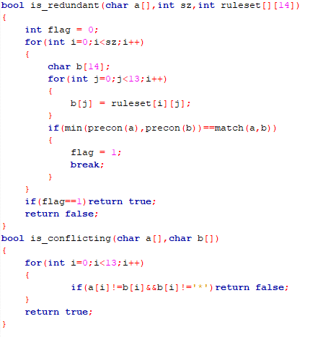

Slide 34
This database contains 13 attributes (which have been extracted from a larger set of 75) Attribute Information: ------------------------ -- 1. age -- 2. sex -- 3. chest pain type (4 values) -- 4. resting blood pressure -- 5. serum cholestoral in mg/dl -- 6. fasting blood sugar > 120 mg/dl -- 7. resting electrocardiographic results (values 0,1,2) -- 8. maximum heart rate achieved -- 9. exercise induced angina -- 10. oldpeak = ST depression induced by exercise relative to rest -- 11. the slope of the peak exercise ST segment -- 12. number of major vessels (0-3) colored by flourosopy -- 13. thal: 3 = normal; 6 = fixed defect; 7 = reversable defect Attributes types ----------------- Real: 1,4,5,8,10,12 Ordered:11, Binary: 2,6,9 Nominal:7,3,13 Variable to be predicted ------------------------ Absence (1) or presence (2) of heart disease where the rows represent the true values and the columns the predicted. No missing values and 270 observations.

Slide 35
Sample heart ruleset
*,*,*,*,*,*,*,3,*,*,*,*,1,0
*,*,3,*,*,*,*,*,*,*,*,*,1,0
*,*,1,*,1,*,*,*,*,*,*,*,*,0
1,*,2,*,*,*,*,*,*,*,*,*,*,0
*,*,*,*,2,*,3,*,*,*,*,*,*,0
*,1,3,*,*,*,*,*,*,*,*,*,*,0
*,*,*,*,*,*,1,*,*,*,*,*,1,0
*,1,*,*,*,*,*,*,*,*,*,2,*,0
*,*,*,*,*,*,*,*,*,2,*,*,2,0
1,*,*,*,*,*,*,1,*,1,*,*,*,0
*,*,*,*,*,*,*,*,*,*,*,2,3,1
*,2,*,*,*,*,*,*,*,*,*,3,*,1
*,*,*,*,*,*,*,*,*,*,2,4,*,1
*,*,2,*,*,*,*,*,*,*,*,*,3,1
*,*,4,*,*,*,*,*,*,3,*,*,*,1
*,*,4,*,*,2,*,*,*,*,*,*,*,1
*,*,*,*,*,2,*,*,*,*,*,*,3,1
*,*,4,*,*,*,*,*,1,*,*,*,3,1
*,*,*,*,*,*,*,*,*,*,*,2,2,1
*,*,4,*,*,*,*,*,*,2,*,*,3,1
*,*,1,*,3,*,*,*,*,*,*,*,*,1
Sample heart data
1,2,2,2,1,2,1,3,1,1,1,1,1,0
2,1,3,2,3,2,3,2,1,1,1,2,1,0
2,2,3,2,1,2,1,3,1,1,1,2,3,0
2,2,1,2,2,2,3,2,1,3,3,1,2,0
2,2,2,2,2,1,3,1,1,1,1,1,1,0
2,1,4,1,1,1,1,1,1,1,1,3,1,0
2,2,2,2,2,1,1,3,1,1,1,1,1,0
2,2,2,2,1,2,3,1,1,1,1,1,1,0
2,2,4,2,3,1,3,2,1,1,2,1,1,0
1,1,3,2,1,1,1,3,1,1,2,1,1,0
1,1,3,2,3,2,1,3,1,1,1,1,1,0
1,1,3,2,1,1,1,2,1,1,1,2,1,0
2,1,3,2,3,1,1,3,1,1,1,2,1,0

Slide 36
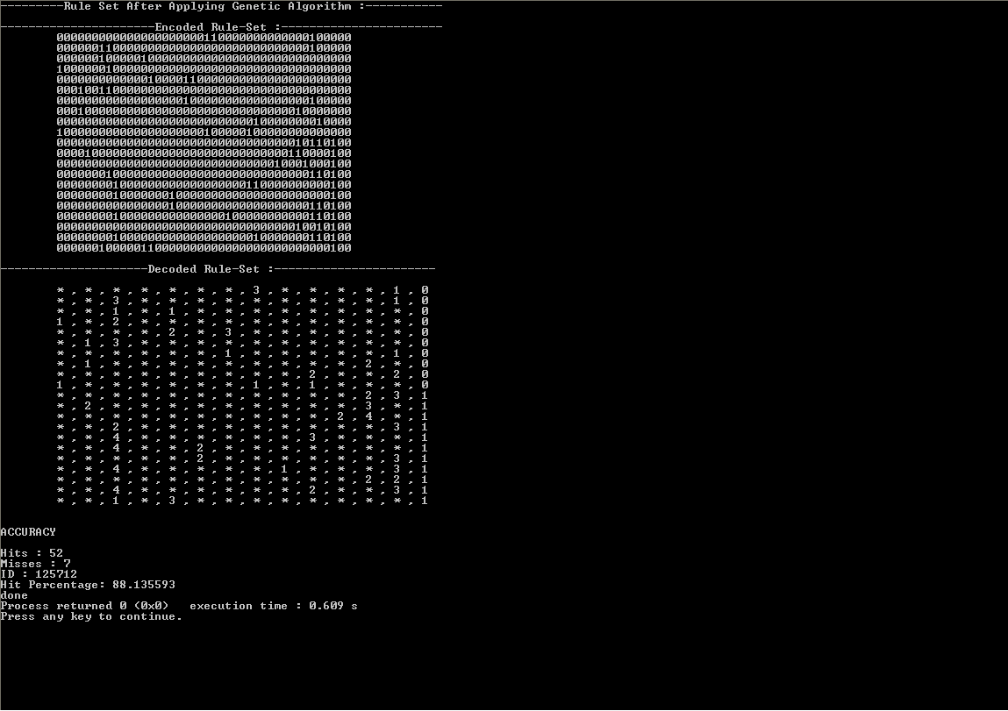

Slide 37

Challenges faced
The programming language barrier : Due to the involvement of HPC, we had to code entirely in C and the lack of predefined libraries and modules, for example rand() function in C is very primitive, posed a big problem. We had to do everything from scratch.
Scarcity of resources on PRISM learner : In search of resources for PRISM, we started learning other similar RI algorithms like ID3 and decision tree classifiers, which made us understand the problem statement even better.

Slide 38
Current progress in the project

Slide 39

What is going to happen next?
Till now, we have been working on the sequential aspect of applying GA over the given problem statement. Now, to enhance the performance we will parallelize the entire model and put endeavours towards getting the best performance out of it.

Slide 40
References
[1] Jadzia Cendrowska, C/O The Faculty of Mathematics, The Open University, Walton Hall, Milton Keynes, MK7 6AA, U.K. (29/05/1987)
[2] Issa Qabajeh, Francisco Chiclana, Centre for Computational Intelligence, De Montfort University, UK; Fadi Thabtah, EBusiness Dept, CUD, Dubai (UAE) : A Classification Rules Mining Method based on Dynamic Rules' Frequency (2015)
[3] Article on Malnutrition Detection and Management System
[4] J. Han, M. Kamber, Data Mining: Concepts and Techniques, Elsevier Inc..
[5] I. H. Witten and E. Frank, Data Mining: Practical Machine Learning Tools and Techniques, 2nd Rule-Based Classification Edition, Elsevier Inc., 2005
[6] Marek Obitko: Genetic Algorithm Library, https://www.codeproject.com
[7] Johannes Furnkranz, Separate-and-Conquer Rule Learning, Austrian Research Institute of Artificial Intelligence

Slide 41
Thank You!

